Slide 1


Slide 2



PowerPoint presentation
By aaryan adhikari (class-8)
Topic : - Artificial Intelligence

Slide 3

Topics to be covered
Introduction to artificial intelligence
Sectors where artificial Intelligence is being used.
Robot made by using artificial intelligence (Sophia).
Advantages of artificial intelligence.
Disadvantages of artificial intelligence.

Slide 4

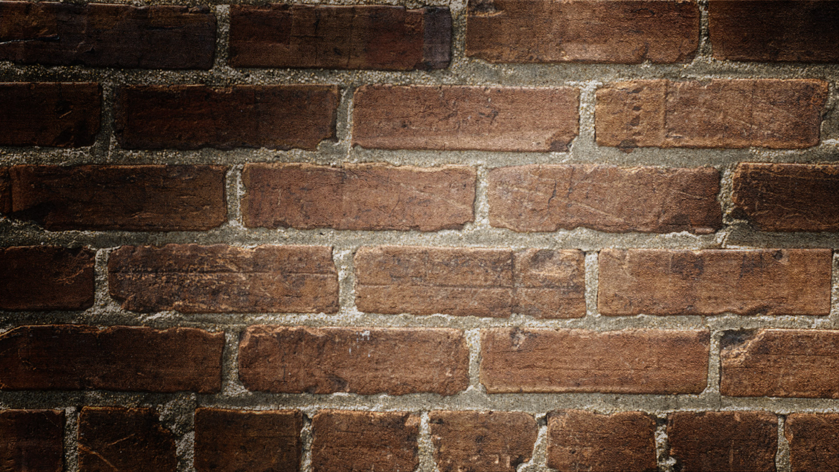
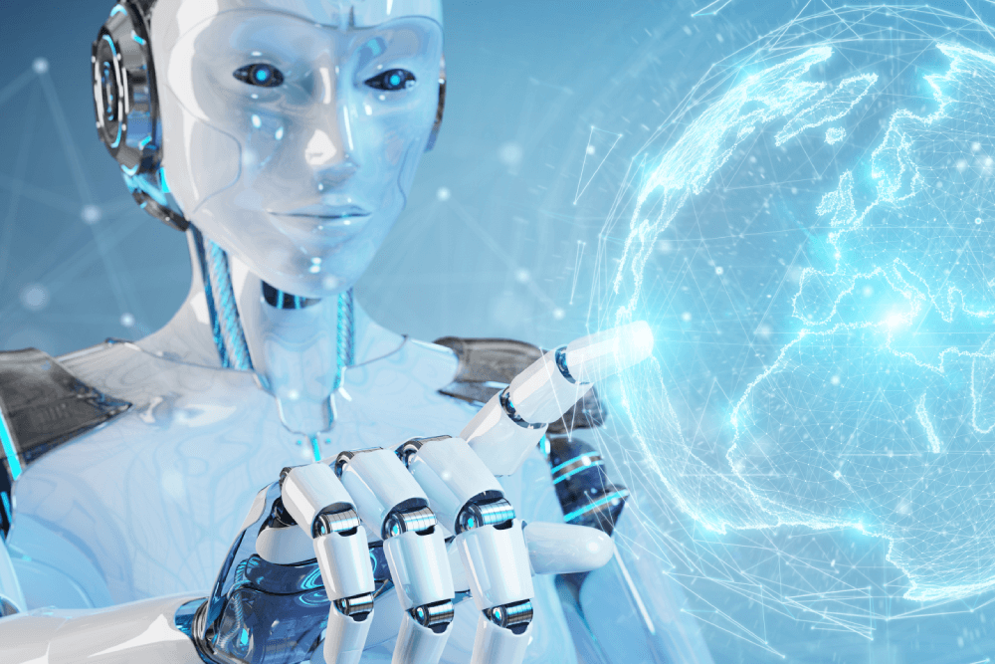
Artificial intelligence (AI)
Artificial intelligence (AI) refers to the representation of human intelligence in machines.
Artificial intelligence are programmed in the machine to make them think like humans.
With artificial intelligence, Machines are able to act like humans and have the feelings and emotions that a normal person have.

Slide 5
John McCarthy is the father of Artificial intelligence.
The beginning of modern artificial intelligence starts from 1956 AD.

Slide 6
Sectors: artificial intelligence is being used.
I
Artificial intelligence is being used at advanced web search engines like youtube, amazon, Netflix , etc.
It is also being used as the human speech understandable in Alexa , google assistant, Siri , etc.
It is also being used in self-driving cars like In Tesla .
It is also widely used in data security today.
It is also used widely in cyber security.
It is also being used in other many sectors and many sources that we daily use.

Slide 7
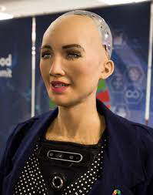
Robot made by using Artificial intelligence.
On February 14, 2016 AD, a Hong Kong based company Hanson Robotics made a robot named Sophia which was made with artificial intelligence. In October 2017, Sophia became a Saudi Arabian citizen. In this robot Sophia, artificial intelligence was used to chat with the other people. This ai based software was designed by David Hanson.

Slide 8
Advantages of Artificial intelligence (ai)
aI decreases the time required to perform a task.
Ai can be used to create a digital assistant for us.
Ai helps in the new inventions which can change our life.
AI decreases the errors if it is coded properly.
Ai can take the decisions itself and can distinguish what is right and what is wrong.

Slide 9
Disadvantages of Artificial intelligence (AI)
We need high costs ,resource and plenty of time to create Ai.
Ai creates laziness in human that can’t do their own work.
People will become unemployed due to ai because ai handles all the woks that a people do.
Ai lacks with creativity as if works with the program that is being fixed.

Slide 10

End of presentation Thank you for viewing my presentation.
Stay safe! Stay healthy!

